Slide 1
Introduction
اَعُوذُ بِاللہِ مِنَ الشَّیِطٰنِ الرَّجِیمْ
بِسْمِ اللہِ الرَّحَمٰنِ الرَّحِیمْ
Note: Some slides and/or pictures are adapted from Lecture slides / Books of
https://www.coursera.org/specializations/deep-learning
https://d2l.ai/chapter_preface/index.html
https://deeplearning.cs.cmu.edu/S23/index.html

Slide 2
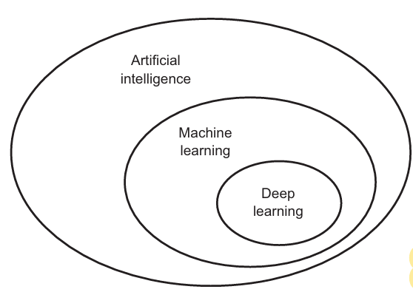
Artificial intelligence, machine learning, and deep learning
AI has been a subject of media hype (ML, DL)
AI - The effort to automate intellectual tasks normally performed by humans.
AI is a general field that encompasses
machine learning and deep learning,
but that also includes many more
approaches that don’t involve any
learning.

Slide 3
Artificial intelligence, machine learning, and deep learning
Early chess programs, for instance, only involved hardcoded rules crafted by programmers, and didn’t qualify as machine learning.
Handcraft a sufficiently large set of explicit rules for manipulating knowledge is also considered as AI. (Symbolic AI) (Expert System)

Slide 4
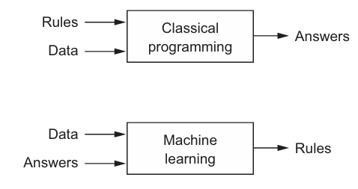
Artificial intelligence, machine learning, and deep learning
Machine learning arises from this question: could a computer go beyond “what we know how to order it to perform” and learn on its own how to perform a specified task?
Could a computer surprise us? Rather than programmers crafting data-processing rules by hand, could a computer automatically learn these rules by looking at data?
A machine-learning system is
trained rather than explicitly
programmed.

Slide 5
Artificial intelligence, machine learning, and deep learning
ML discovers rules to execute a data-processing task, given examples of what’s expected
Input data points – text, images, sounds, videos
Examples of the expected output –
A way to measure whether the algorithm is doing a good job – The measurement is used as a feedback signal to adjust the way the algorithm works. This adjustment step is what we call learning.
The central problem in machine learning and deep learning is to meaningfully transform data: in other words, to learn useful representations of the input data at hand—representations that get us closer to the expected output.

Slide 6
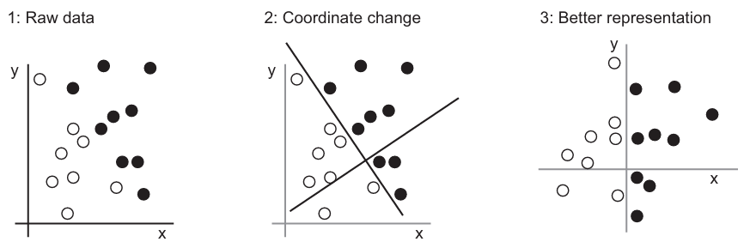
Artificial intelligence, machine learning, and deep learning
Learning, in the context of machine learning, describes an automatic search process for better representations.
Machine-learning algorithms aren’t usually creative in finding these transformations; they’re merely searching through a predefined set of operations, called a hypothesis space.

Slide 7
Artificial intelligence, machine learning, and deep learning
Deep learning is a specific subfield of machine learning: a new take on learning representations from data that puts an emphasis on learning successive layers of increasingly meaningful representations.
The deep in deep learning isn’t a reference to any kind of deeper understanding achieved by the approach; rather, it stands for this idea of successive layers of representations.
How many layers contribute to a model of the data is called the depth of the model.
Other appropriate names for the field could have been layered representations learning and hierarchical representations learning.

Slide 8
Artificial intelligence, machine learning, and deep learning
Modern deep learning often involves tens or even hundreds of successive layers of representations— and they’re all learned automatically from exposure to training data.
Meanwhile, other approaches to machine learning tend to focus on learning only one or two layers of representations of the data; hence, they’re sometimes called shallow learning.
In deep learning, these layered representations are (almost always) learned via models called neural networks, structured in literal layers stacked on top of each other.

Slide 9
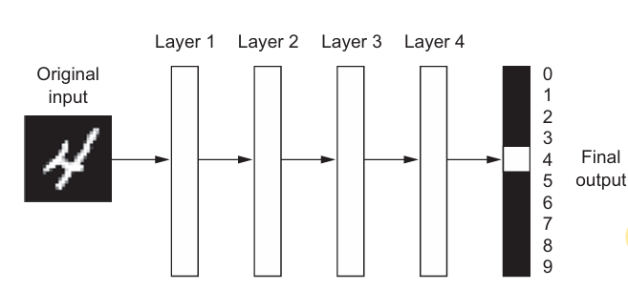
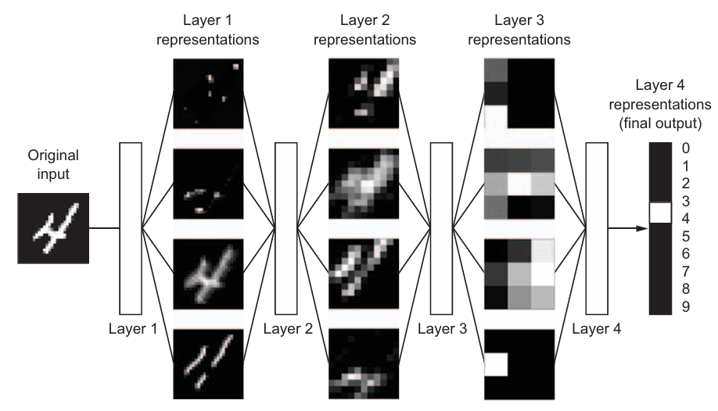
Artificial intelligence, machine learning, and deep learning
Notes:
the network transforms the digit image into representations that are increasingly different from the original image and increasingly informative about the final result. You can think of a deep network as a multistage information-distillation operation, where information goes through successive filters and comes out increasingly purified.
So that’s what deep learning is, technically: a multistage way to learn data representations. It’s a simple idea—but, as it turns out, very simple mechanisms, sufficiently scaled, can end up looking like magic.

Slide 10
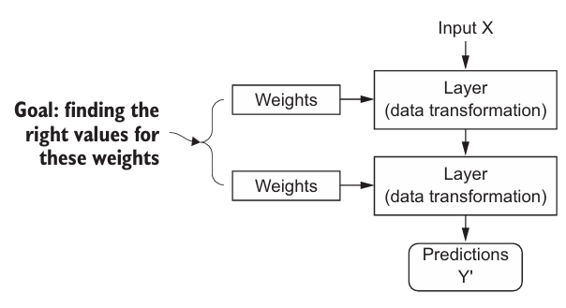
How Deep Learning works
ML is about mapping inputs to targets
Deep Neural Network (DNN) do this mapping via a deep sequence of simple data transformations (layers) and that these data transformations are learned by exposure to exampless.
The specification of what a layer does to its input data is stored in the layer’s weights, which in essence are a bunch of numbers.
In technical terms, the transformation implemented by a layer is parameterized by its weights
Notes:
At this point, you know that machine learning is about mapping inputs (such as images) to targets (such as the label “cat”), which is done by observing many examples of input and targets.
You also know that deep neural networks do this input-to-target mapping via a deep sequence of simple data transformations (layers) and that these data transformations are learned by exposure to examples.

Slide 11
How Deep Learning works
To control something, first you need to be able to observe it.
To control the output of a neural network, you need to be able to measure how far this output is from what you expected.
This is the job of the loss function of the network, also called the objective function.
The loss function takes the predictions of the network and the true target (what you wanted the network to output) and computes a distance score, capturing how well the network has done on this specific example.

Slide 12
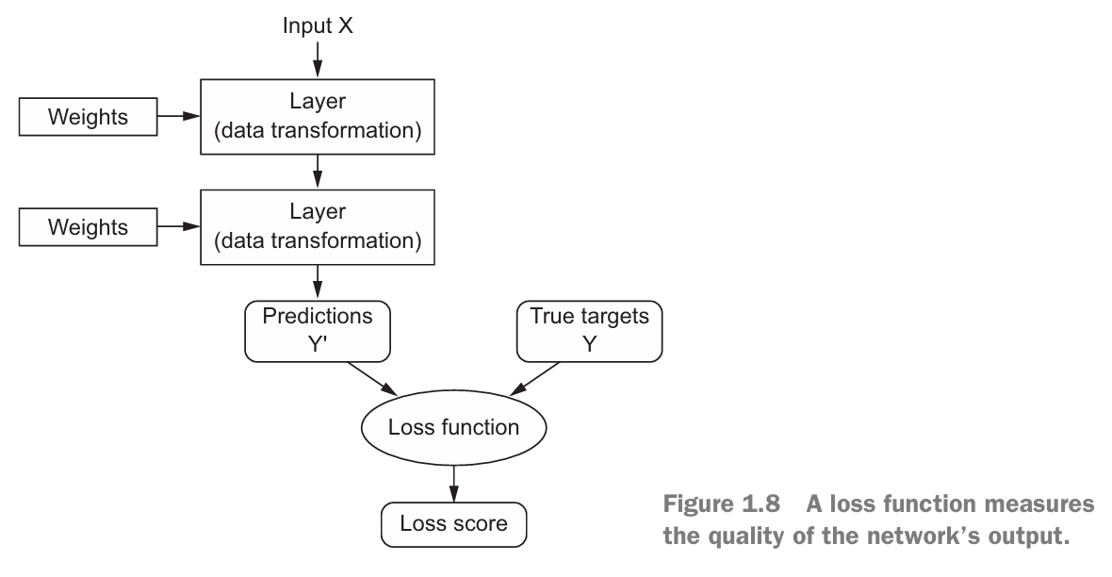
How Deep Learning works

Slide 13
How Deep Learning works
The fundamental trick in deep learning is to use this score as a feedback signal to adjust the value of the weights a little, in a direction that
will lower the loss score for the current example.
This adjustment is the job of the optimizer, which implements what’s called the Backpropagation algorithm: the central algorithm in deep learning.
Initially, the weights of the network are assigned random values, so the network merely implements a series of random transformations.
Naturally, its output is far from what it should ideally be, and the loss score is accordingly very high.

Slide 14
How Deep Learning works
But with every example the network processes, the weights are adjusted a little in the correct direction, and the loss score decreases.
This is the training loop, which, repeated a sufficient number of times (typically tens of iterations over thousands of examples), yields weight values that minimize the loss function.
A network with a minimal loss is one for which the outputs are as close as they can be to the targets: a trained network.
Once again, it’s a simple mechanism that, once scaled, ends up looking like magic.

Slide 15
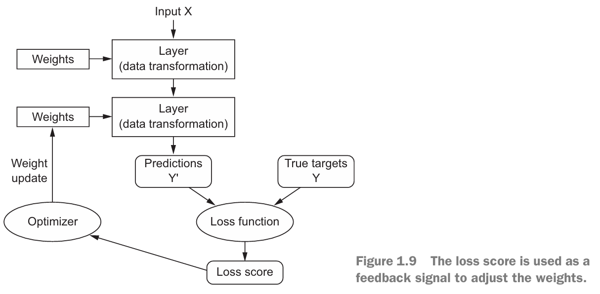
How Deep Learning works

Slide 16
Neural Networks are taking over!
What are neural networks in simple words?
A neural network is a method in artiﬁcial intelligence that teaches computers to process data in a way that is inspired by the human brain
Neural Networks have become one of the major thrust areas recently in various pattern recognition, prediction, and analysis problems
Established state-of-the-art in many problems, often exceeding the previous benchmarks by large margins

Slide 17
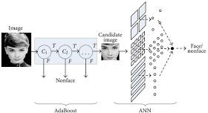
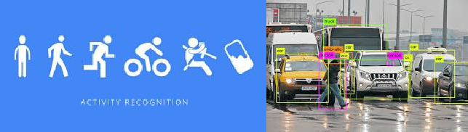
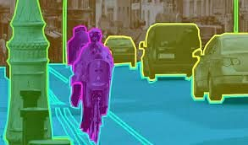
Breakthrough with Neural Networks
Vision/ Perception - Face Detection,Face Recognition, Object Detection, Semantic Segmentation, Pose Estimation, Activity Recognition, Emotion Detection, Biometrics and forensics.

Slide 18


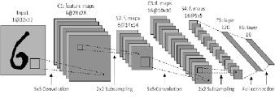
Breakthrough with Neural Networks
Audio- Voice Assistants, ChatBots, Speech Recognition, machine Translation
Text - Handwriting Recognition, text to speech recognition

Slide 19
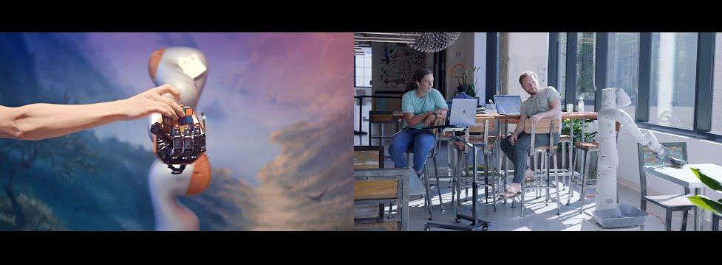
Breakthrough with Neural Networks
Robotics- Perception, Navigation, Guidance and control, Grasp Detection, Robot manipulation.

Slide 20
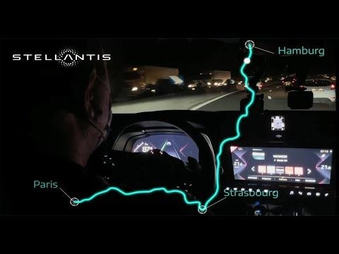
Breakthrough with Neural Networks
Self-Driving Cars- Behaviour Prediction,Interpreting human actions,Task planning, Scene Understanding, Sensor Fusion, End-to-End Control

Slide 21
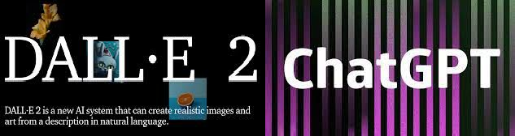
Most Recent
DALL-E- 2
ChatGPT

Slide 22
What deep learning has achieved so far
Near-human-level image classification
Near-human-level speech recognition
Near-human-level handwriting transcription
Improved machine translation
Improved text-to-speech conversion
Digital assistants such as Google Now and Amazon Alexa
Near-human-level autonomous driving
Improved ad targeting, as used by Google, Baidu, and Bing
ChatGPT (LLM)

Slide 23
Why deep learning? Why now?
Hardware
Datasets and benchmarks
Algorithmic advances

Slide 24
Why is deep learning taking off?
Performance
Amount of data

Slide 25
Q&A

